Slide 1

ANALYZING THE IMPACT OF CAR FEATURES ON PRICE AND PROFITABILITY
NAME: MUSKAN PRITAM

Slide 2

PROBLEM STATEMENT

Slide 3
PROBLEM STATEMENT:
The automotive industry is evolving with a focus on fuel efficiency, sustainability, and technology. Consumers are increasingly interested in electric, hybrid, and alternative fuel vehicles alongside traditional gasoline cars. Manufacturers need to optimize pricing and product development decisions to maximize profitability while meeting diverse consumer demands. This involves analyzing car features, market categories, and pricing using techniques like regression analysis and market segmentation to develop effective strategies and prioritize future product development efforts.

Slide 4
THE VARIABLES IN THE DATASET:
Make: the make or brand of the car
Model: the specific model of the car
Year: the year the car was released
Engine Fuel Type: the type of fuel used by the car (gasoline, diesel, etc.)
Engine HP: the horsepower of the car's engine
Engine Cylinders: the number of cylinders in the car's engine
Transmission Type: the type of transmission (automatic or manual)
Driven_Wheels: the type of wheels driven by the car (front, rear, all)
Number of Doors: the number of doors the car has
Market Category: the market category the car belongs to (Luxury, Performance, etc.)
Vehicle Size: the size of the car
Vehicle Style: the style of the car (Sedan, Coupe, etc.)
Highway MPG: the estimated miles per gallon the car gets on the highway
City MPG: the estimated miles per gallon the car gets in the city
Popularity: a ranking of the popularity of the car (based on the number of times it has been viewed on Edmunds.com)
MSRP: the manufacturer's suggested retail price of the car

Slide 5

Dataset Overview : Contains data on 11,000+ car models with details like make, model, year, fuel type, MPG, popularity, and MSRP.
Insights :
- Trends : Analyze changes in car features and pricing over time.
- Fuel Efficiency : Compare MPG across different car types.
- Popularity : Investigate factors influencing car popularity.
- Price Prediction : Develop models to forecast car prices based on features.
Applications : Guides product development, marketing strategies, and pricing decisions in the automotive industry.
Value : Provides comprehensive insights into consumer preferences and market dynamics.
The given tasks below based on the business problem would require advanced Excel skills and knowledge of data analysis techniques such as regression analysis, pivot tables, sensitivity analysis, optimization, and time series analysis.

Slide 6

FIRST TASK
ANALYSIS

Slide 7
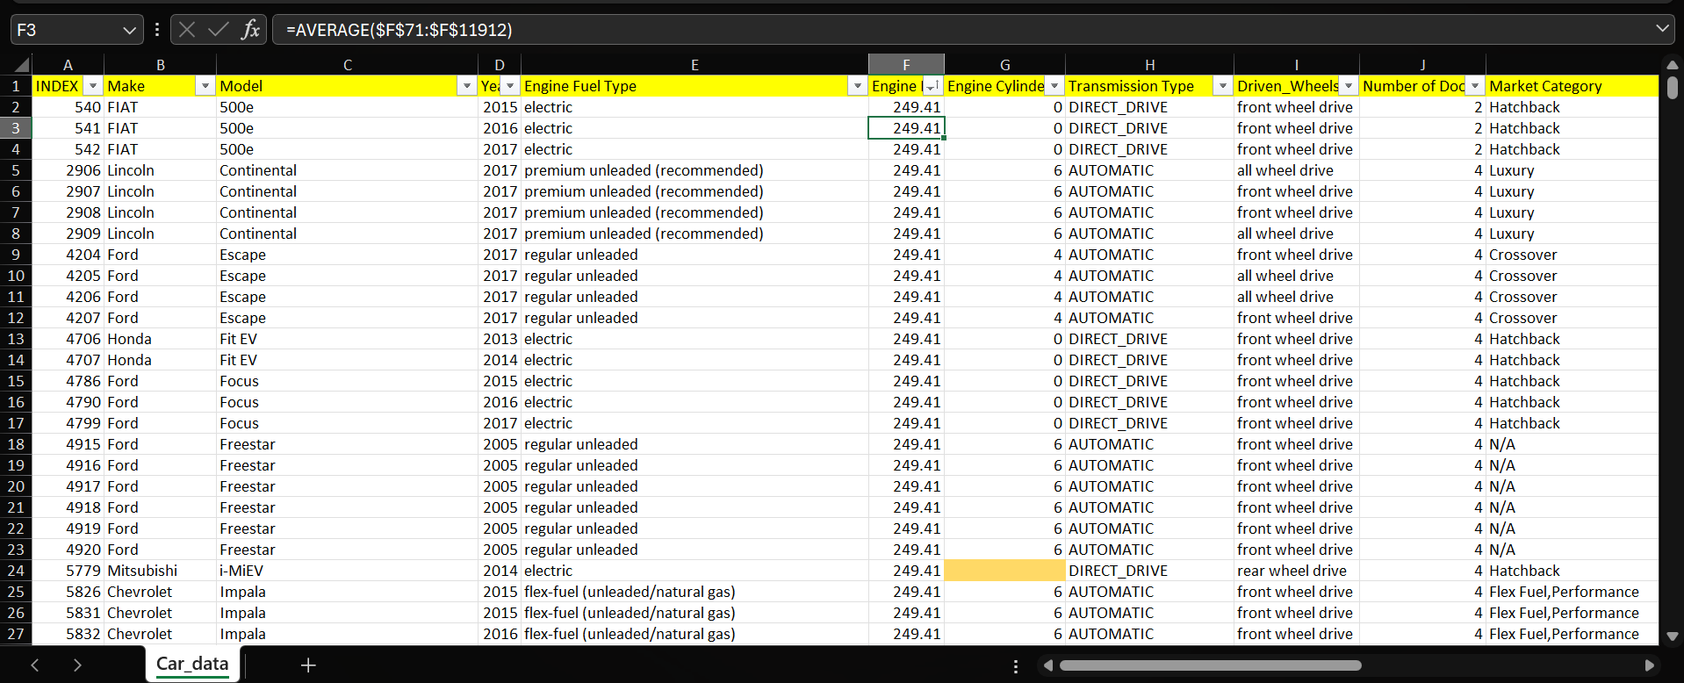
Before starting the task given to us for analysis we first have to convert the whole data into desirable form. So for that we inserted a new column named index and number it from 1 to the last cell of the data that is 11912. Now after doing this I use conditional formatting to highlight the black cells and used average formula for filling up those cells ,also if the number of blank cells is almost negligible that is only 3 or 4, we deleted those records to make it appropriate to work with. Then after doing all those calculations we sorted the index column in ascending to descending order so that we get our original data back.

Slide 8

TASK 1:
How does the popularity of a car model vary across different market categories?
Task 1.A: Create a pivot table that shows the number of car models in each market category and their corresponding popularity scores.
Task 1.B: Create a combo chart that visualizes the relationship between market category and popularity.

Slide 9
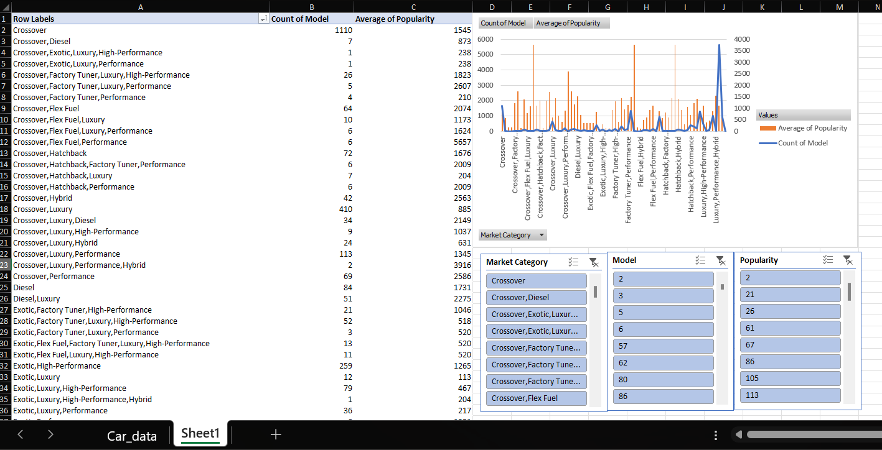
In this task, we are asked to find the popularity of the car model and how that varies across different market categories. So in task 1 we were asked to plot a pivot table. in Above snapshot we can see that we have different categories of model along with the count each model in those categories with the average popularity of each category. For this pivot table we dragged the category column into row and the model and popularity column into values, after that we set the model to count and the popularity to average, by default they both are sum.

Slide 10
As we can see in the graph beside , we have a combo chart consisting of line and bar graph. So by analysing the graph we can say that for different market categories the number of models and the average of popularity can differ. In the graph, the yellow bars show average popularity and the blue line shows the count of model for each category. After looking further into the graph we can see that many categories have the average popularity more than the other categories but their count of models is quite less, one of the example s category having crossover, flex fuel, performance ,also in few of the places we can see that the popularity is not much but the count of model in those categories are quite high than the other, one of the example is the category having luxury, performance ,hybrid. We have also used slicers For analysing different types of categories or models or popularity in real time. we can choose whatsoever we want to search and analyse according to our choices.

Slide 11

TASK 2:
What is the relationship between a car's engine power and its price?
Task 2: Create a scatter chart that plots engine power on the x-axis and price on the y-axis. Add a trendline to the chart to visualize the relationship between these variables.

Slide 12
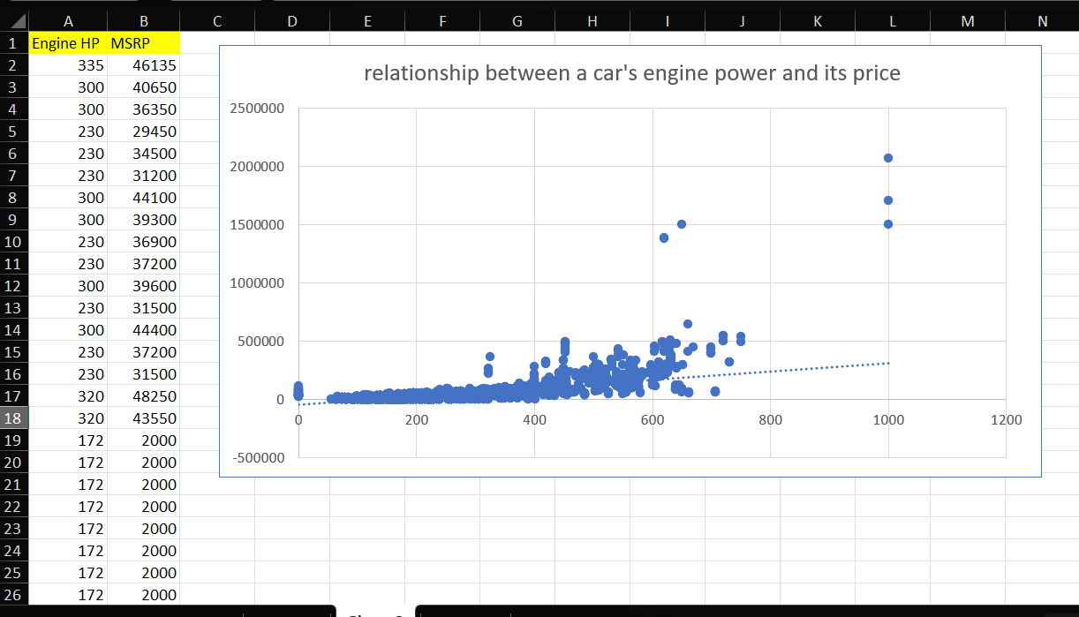
In This task we were asked to find the relationship between car’s engine power that is horse power and its price. So in a new sheet we copied the engine HP and MSRP which is the price of the car, and plotted a scatter chart to find the relationship between car’s engine power and its price. Also we were asked to add a trend line to the chart to visualise that relationship. So after analysing we can say that as we increase the car’s horse power its price will also increase with it. Also we can see in the graph that few of the cars have horse power of 1000 and its price is also too high to afford.

Slide 13
TASK 3:
Which car features are most important in determining a car's price?
Task 3: Use regression analysis to identify the variables that have the strongest relationship with a car's price. Then create a bar chart that shows the coefficient values for each variable to visualize their relative importance.

Slide 14
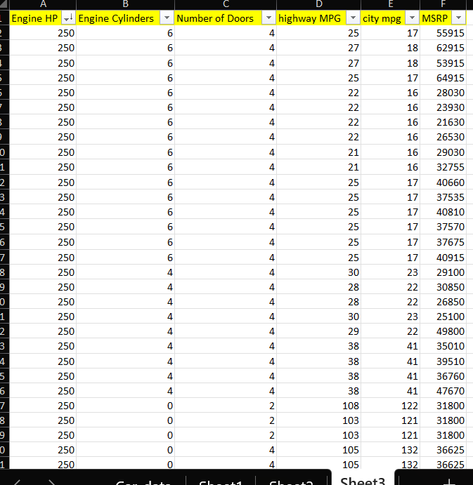
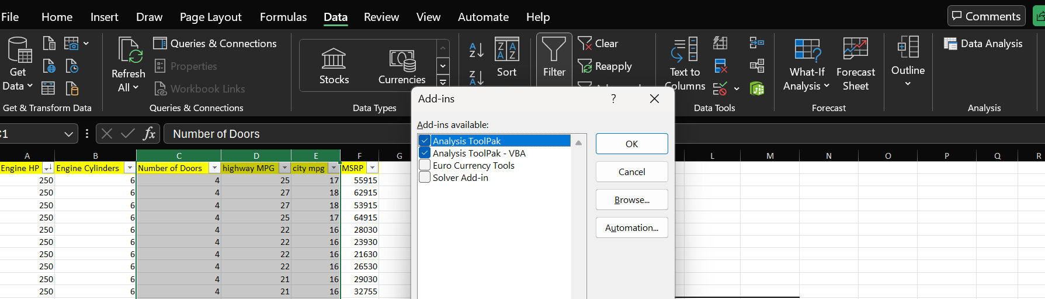
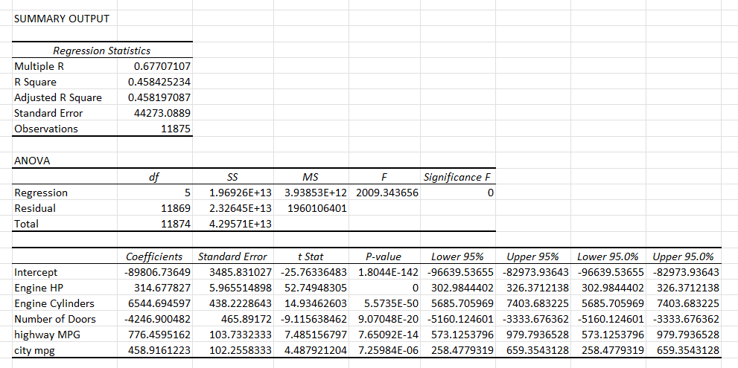
In this Task there are asked to determine a cars price by analysing the cars feature. So we use regression analysis to identify the variables that have the strongest relationship with cars price. In the above snapshots we can see that will have to add the addins available in the excel sheet to Perform regression analysis. We can find data analysis in the data section on the ribbon then selecting the data analysis after then selecting regression along with the range to get the regression statistics summary output. In this summary output we can see that we have multiple values search as coefficient standard deviation t stat etc, Which can help in analysis of the following range in a proper way.

Slide 15
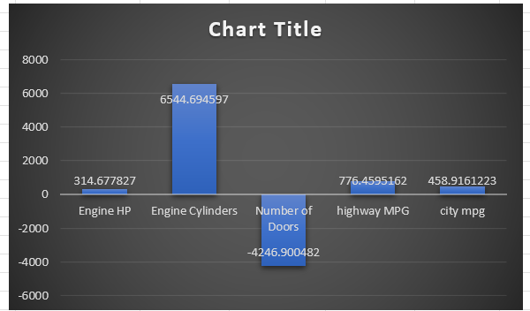
In the chart beside we can see that we have coefficient values of multiple variables and according to this graph we can see that engine cylinders have the highest coefficient value whereas the number of doors have the lowest coefficient value and the others are in the middle. Which means that engine cylinders are the most important in determining cars price and the number of doors have to lowest relation in determining a cars price.

Slide 16
TASK 4:
How does the average price of a car vary across different manufacturers?
Task 4.A: Create a pivot table that shows the average price of cars for each manufacturer.
Task 4.B: Create a bar chart or a horizontal stacked bar chart that visualizes the relationship between manufacturer and average price.

Slide 17
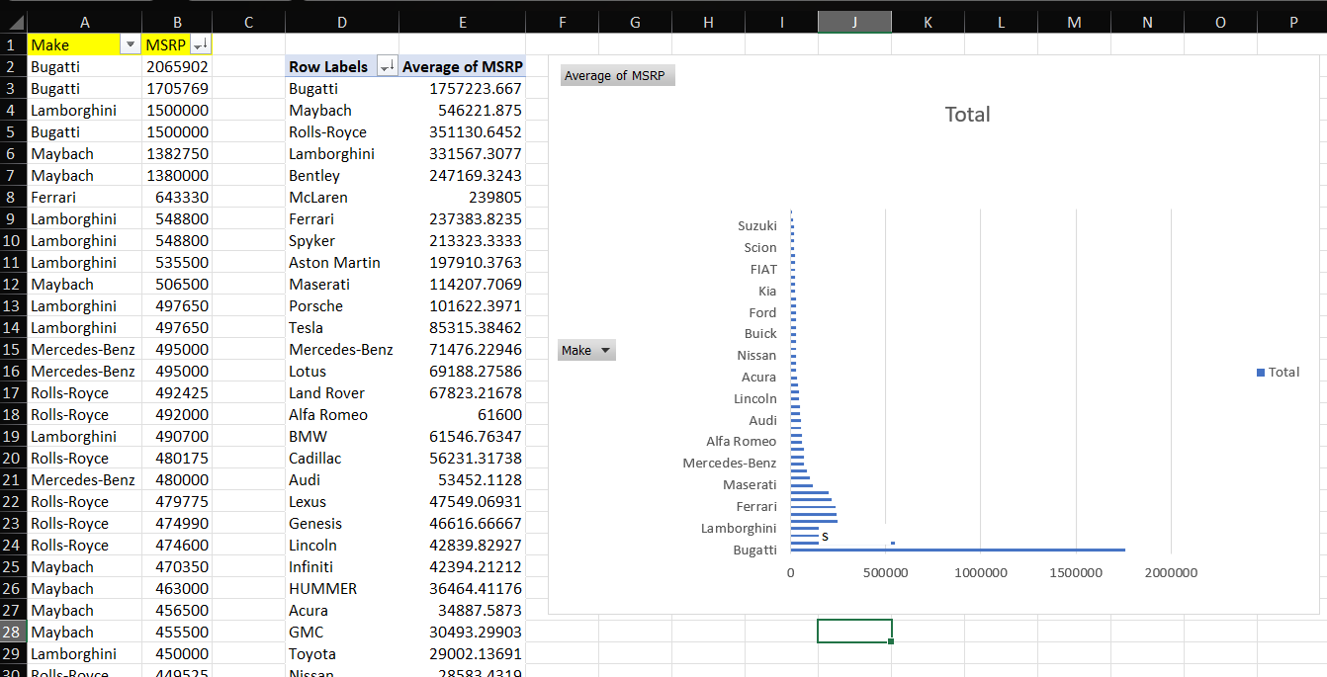
In this task were asked to find the average price of a car which vary across different manufacturers. So for that we used to different columns namely make and MSRP for the following analysis. We used the pivot table for the analysis so in the row section we dragged the column Make and in the value section we dragged the column MSRP to find the average of each make separately. So in the above photo we can see that each manufacturer have an average of how much price. Also we were asked to create a horizontal stacked bar chart that visualises the relationship between manufacturer and average price, according to the chart, Bugatti have the highest average price among all the other manufacturers.

Slide 18
TASK 5:
What is the relationship between fuel efficiency and the number of cylinders in a car's engine?
Task 5.A: Create a scatter plot with the number of cylinders on the x-axis and highway MPG on the y-axis. Then create a trendline on the scatter plot to visually estimate the slope of the relationship and assess its significance.
Task 5.B: Calculate the correlation coefficient between the number of cylinders and highway MPG to quantify the strength and direction of the relationship.

Slide 19
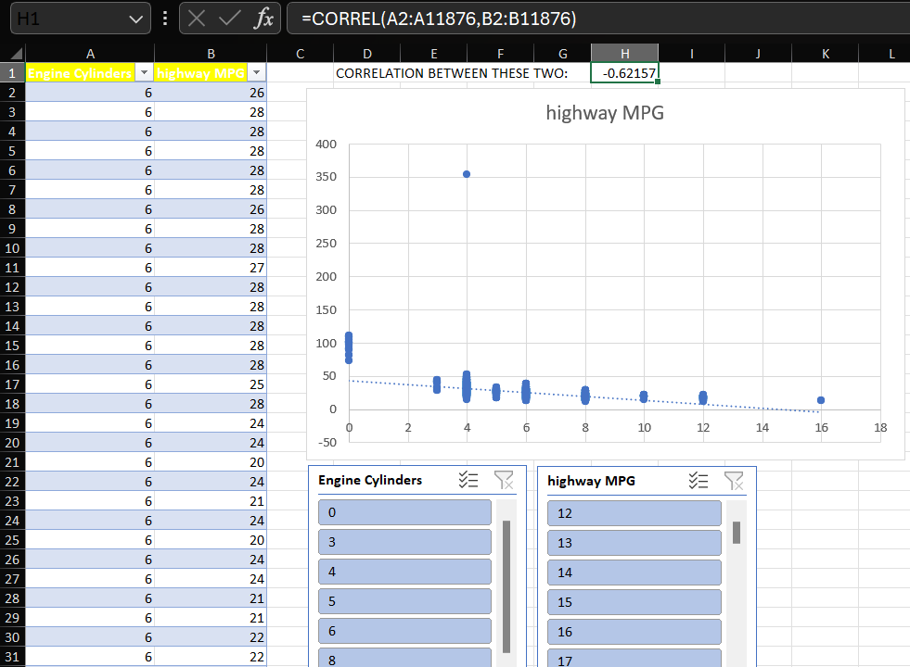
In this task we were asked to find the relationship between the fuel efficiency and cylinders in a car’s engine. so for that we used two columns namely highway MPG and engine cylinders. we were also asked to find the correlation between the two so we used the correl function for that which came out to be -0.62157 which means that there is negative correlation that is there is absolutely no relation between the two. We were also asked to plot a scatter graph with the number of cylinders on the X axis and highway mpg on y axis. We added a trendline to see where the graph is going, as we can see in the snapshot beside as the number of cylinders increase, highway mpg is decreasing which means that they are inversely related, that is, if one increases the other decreases. We also added slicers for performing analysis on engine cylinder or highway mpg according to us in real time for different values.

Slide 20

BUILDING THE DASHBOARD

Slide 21
TASK 1:
How does the distribution of car prices vary by brand and body style?
Hints: Stacked column chart to show the distribution of car prices by brand and body style. Use filters and slicers to make the chart interactive. Calculate the total MSRP for each brand and body style using SUMIF or Pivot Tables.

Slide 22
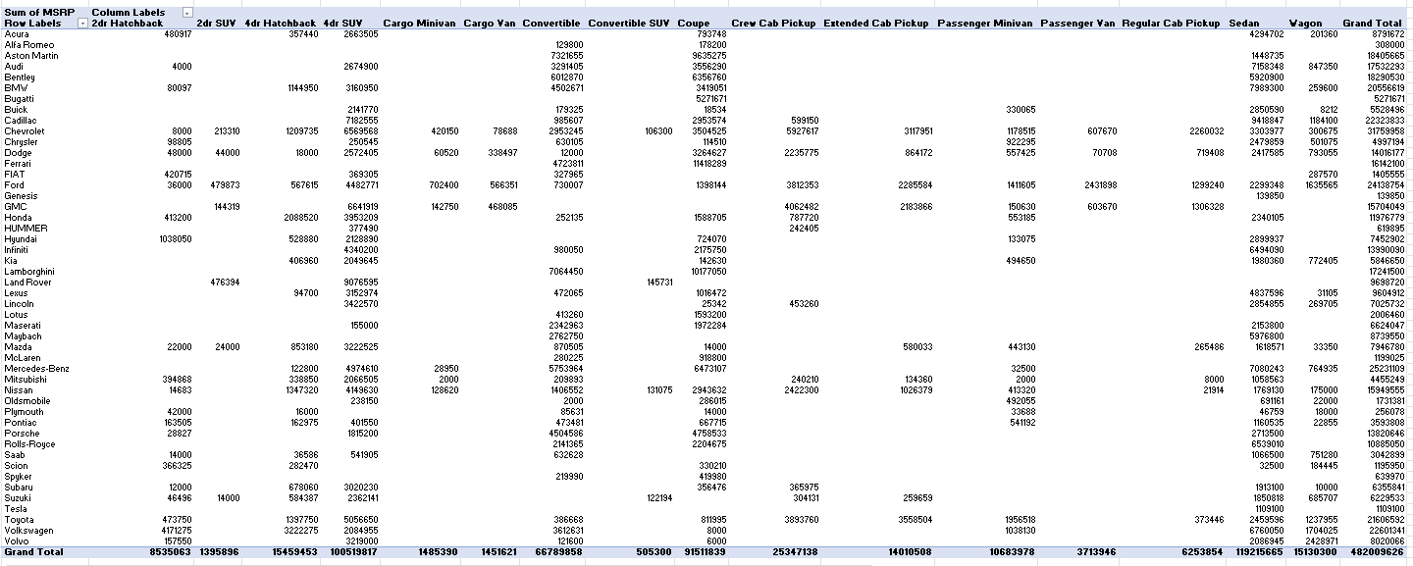
In this task we are asked to find the distribution of cars prize varying across different brands and body style. In above snapshot we can see that I have used the column brand also known as make as the row value in the pivot table, used the body style value in the column section and now for the value section I dragged the value MSRP as sum of msrp and thus got the different values for a particular brand along with a particular body style using the pivot table.

Slide 23
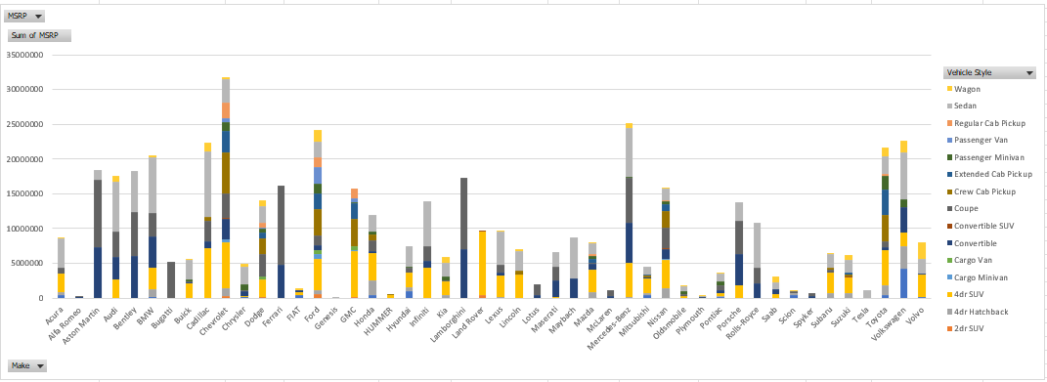
In above graph we used to stacked column chart to show the distribution of car’s prices by brand and body style. so on the X axis we have the brand of the car and on the Y axis we have the sum of price for different make and style. The bars show the stacked value of different vehicle styles. According to the chart we can see that Chevrolet have the highest sum of prices among the others.

Slide 24
TASK 2:
Which car brands have the highest and lowest average MSRPs, and how does this vary by body style?
Hints: Clustered column chart to compare the average MSRPs across different car brands and body styles. Calculate the average MSRP for each brand and body style using AVERAGEIF or Pivot Tables.

Slide 25
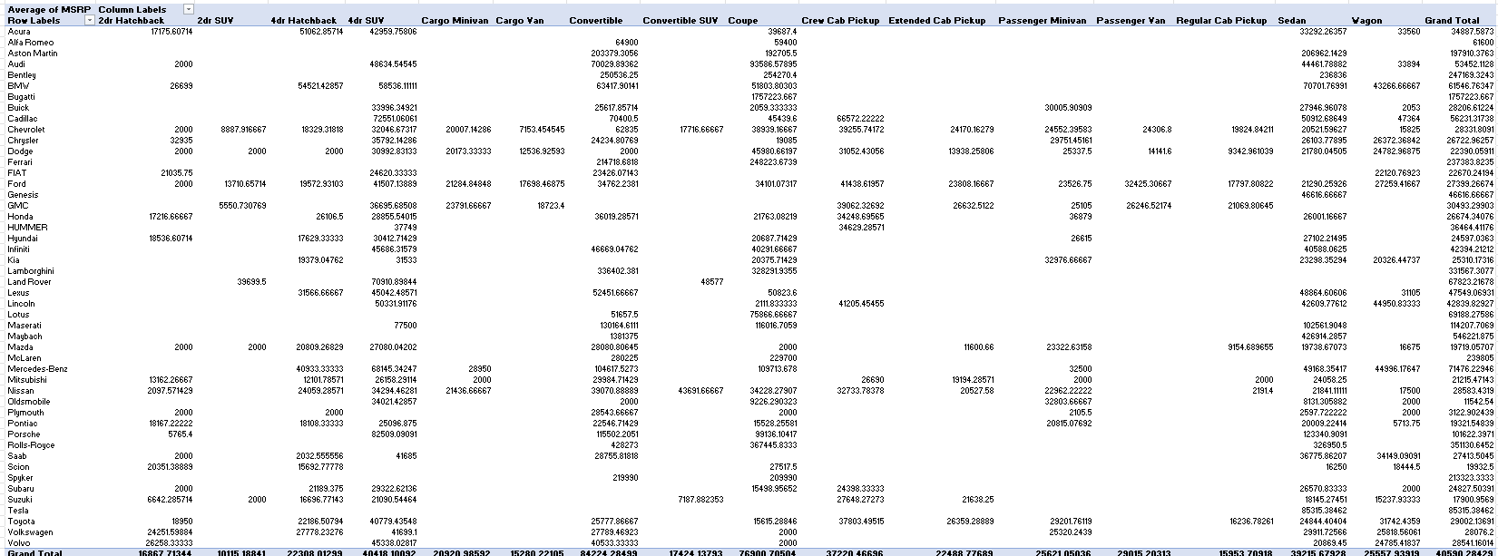
In this task we are asked to find the highest and lowest average MSRP for car brands and also how does this vary with body style. Similarly as the previous task we dragged body style into columns and brand into rows, and in the value column we took the average of msrp. After that we got the following table as shown above having rows as brand and columns of style along with their particular average MSRP as values for analysis.

Slide 26
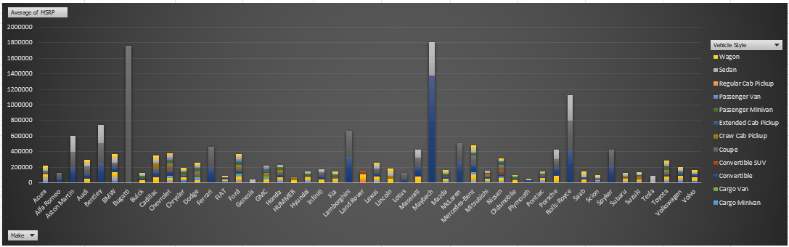
In this slide begin see a clustered column chart to compare the average MSRP across different brands and body style. After analysing chart it's clear that maybach has the highest average MSRP among all and Plymouth have the lowest average MSRP among all. We can see that we have different colours column representing different vehicle styles as mentioned beside.

Slide 27
TASK 3:
How do the different feature such as transmission type affect the MSRP, and how does this vary by body style?
Hints: Scatter plot chart to visualize the relationship between MSRP and transmission type, with different symbols for each body style. Calculate the average MSRP for each combination of transmission type and body style using AVERAGEIFS or Pivot Tables.

Slide 28
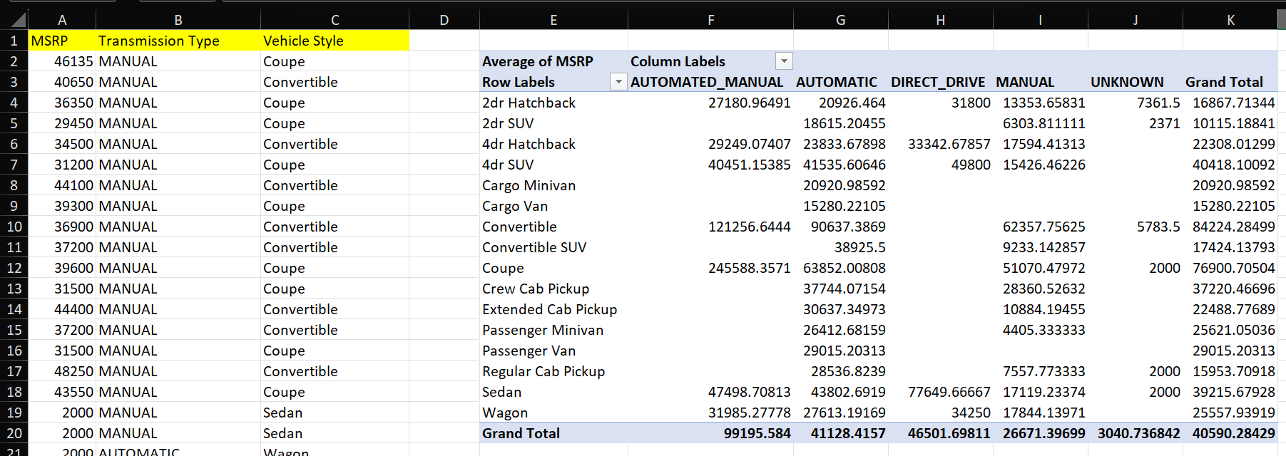
In this task we were asked to find the features that affect the MSRP such as transmission type and also how does this vary by body style. So we took 3 columns such as MSRP transmission type and vehicle style for the pivot table. in the pivot table for Rows we dragged the vehicle style, in the column we dragged the transmission type and in the value section we dragged the MSRP to find the average of MSRP for the analysis of the above task.

Slide 29
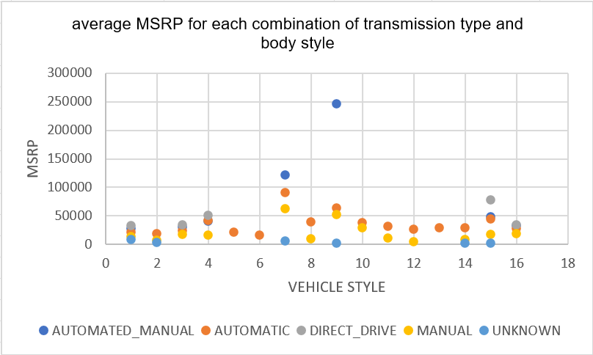
In this scatter plot we were asked to visualise the relationship between msrp and transmission type along with body style. We can see the chart having blue dot representing that its automated and manual transmission type car and its body style is coupe. There are various transmission types represented by different colours and vehicle style is represented with numbers. we can analyse this chart to get different types of average MSRP for particular transmission type and body style.

Slide 30
TASK 4:
How does the fuel efficiency of cars vary across different body styles and model years?
Hints: Line chart to show the trend of fuel efficiency (MPG) over time for each body style. Calculate the average MPG for each combination of body style and model year using AVERAGEIFS or Pivot Tables.

Slide 31
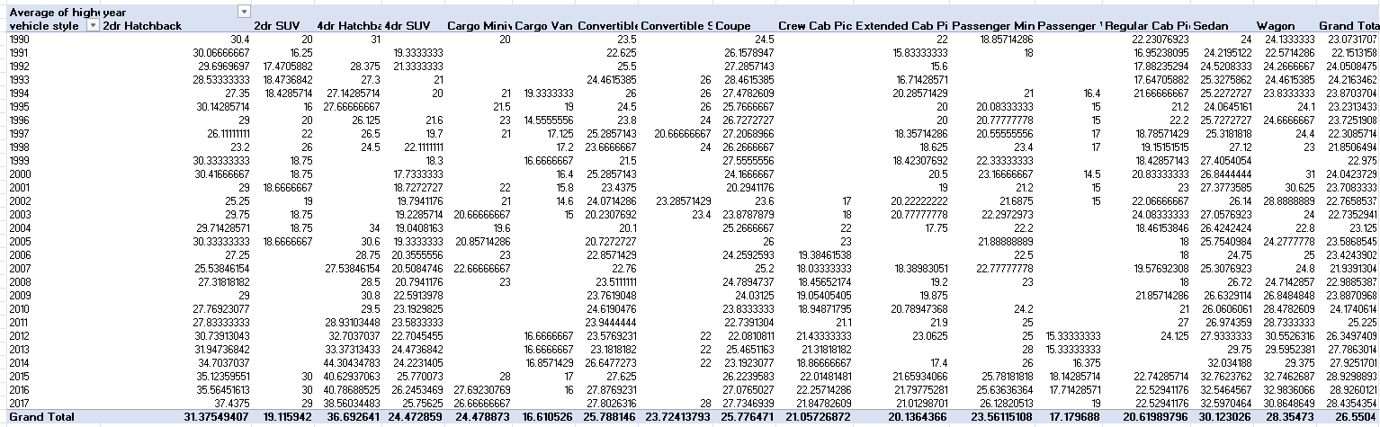
In task we were asked found the fuel efficiency of cars varying across different body styles and model years. So to make a pivot table we dragged the vehicle model year into row and for the column value be dragged the body styles .similarly for values we dragged the fuel efficiency that is mpg to take its average for analysis. Thus we can see in the above snapshot that we have vehicle style in row and transmission type in column along with their each highway mpg.

Slide 32
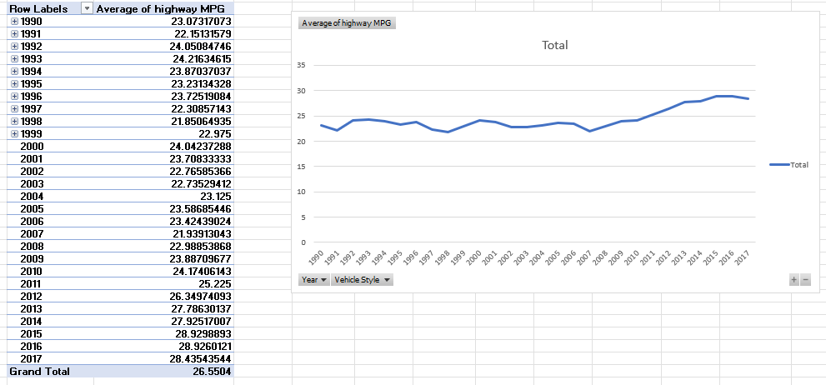
Also we were asked to plot the line chart to show the trend of fuel efficiency over time for each body style so in the graph we can see that from the year 1990 to the year 2007 the graph was almost constant which means as the year increased the highway mpg remained almost constant but after that increased till 2016. For the pivot table in above chart we used two rows first one is the year and second one was the transmission style along with value highway Mpg. If we click the plus sign beside the years we can have different types of transmission style that was in that year along with their average highway mpg and also the graph will change according to that. So it is very useful for analysis if we want to see for different years and different transmission types along with its chart.

Slide 33
TASK 5:
How does the car's horsepower, MPG, and price vary across different Brands?
Hints: Bubble chart to visualize the relationship between horsepower, MPG, and price across different car brands. Assign different colors to each brand and label the bubbles with the car model name. Calculate the average horsepower, MPG, and MSRP for each car brand using AVERAGEIFS or Pivot Tables.

Slide 34
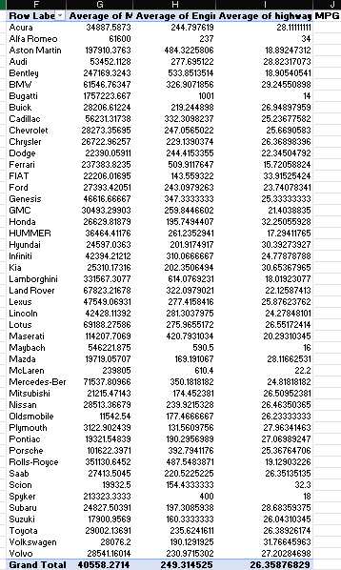
In this task were asked to find how cars horsepower, MPG and price vary across different brands. So for the pivot table we dragged brands in row and 3 different columns into value section that is engine HP ,highway mpg and MSRP, and took their averages for the analysis according to task. So in the pivot table we get different manufacturers for which we have different average values according to MSRP ,engine hp and highway mpg.

Slide 35
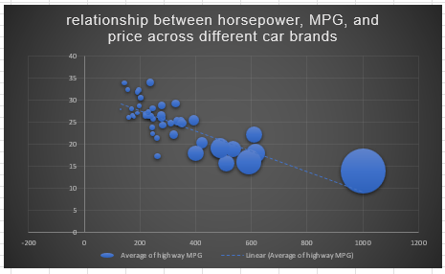
Chart beside is the bubble chart which was asked to plot to visualise the relationship between horse power, mpg and price according to different car brands. We also added a trend line which shows a downward direction which means the average of highway mpg is decreasing on the way. Different size of bubbles show the different value of averages, a bigger average number shows a larger bubble similarly for the low average value.

Slide 36

THANK YOU ALL

